Slide 1
Welcome!
8th Grade Creative Writing

Slide 2

Get your ticket!
- ACTIVITY 1 -
- ACTIVITY 3 -
- WELCOME -
- WELCOME -
- WELCOME -
- ACTIVITY 5 -
- ACTIVITY 2 -
- ACTIVITY 4 -
- ACTIVITY 6 -
- WELCOME -
- WELCOME -
- WELCOME -

Slide 3

Activity 1
If you could be invisible any time you wanted, where would you go and what would you do? What would you be curious to find out?
ACTIVITY
0000001

Slide 4
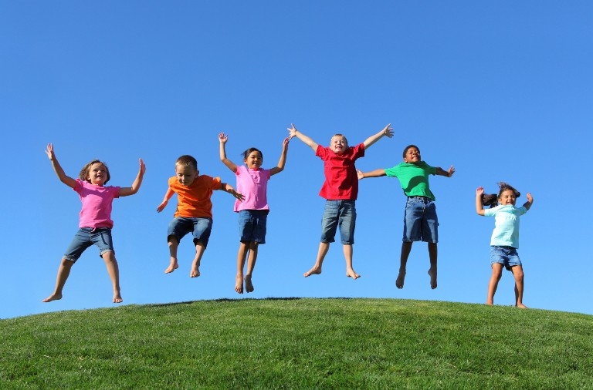
Activity 2
What would happen if children ruled the world?
Describe what life would be like. What would you eat? What would you wear? What would you do every day?
ACTIVITY
0000002

Slide 5
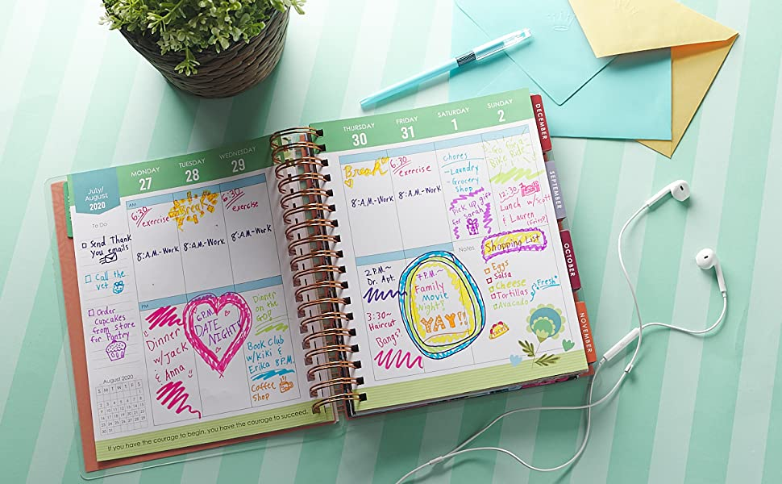
Activity 3
Poetry: 7 Lines, 7 Days
Write a poem where each line is about a day of the week.
ACTIVITY
0000003

Slide 6
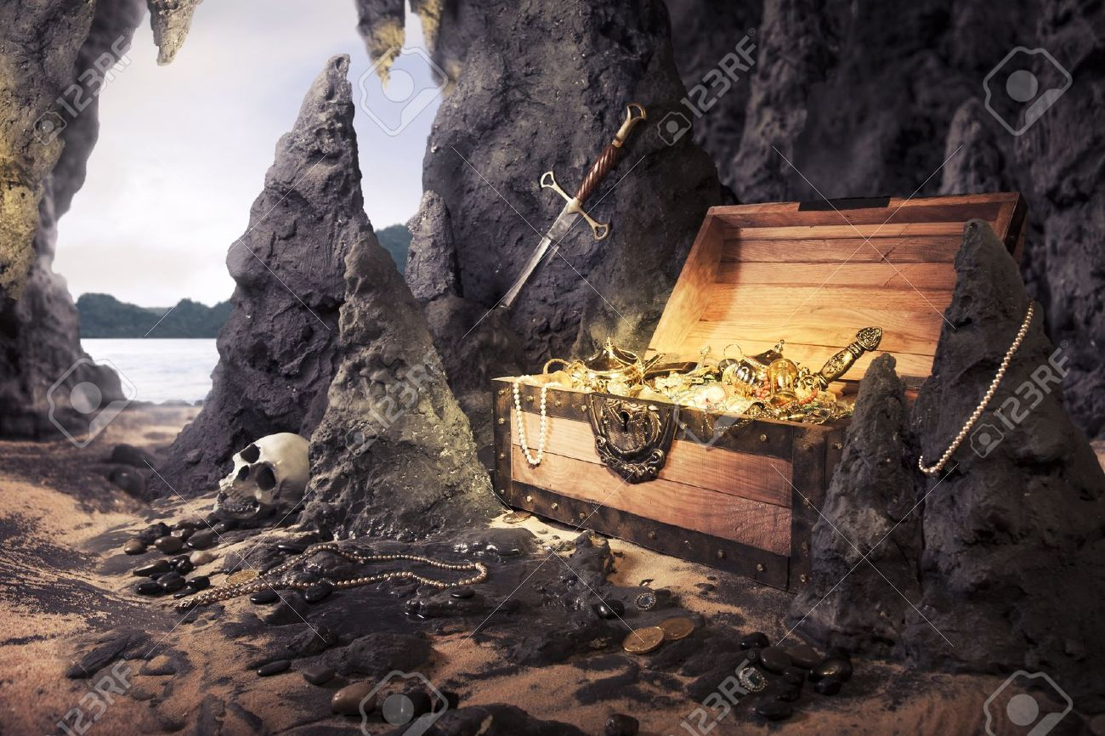
Activity 4
What would happen if you found gold in your backyard? What would you do? How would your life change?
ACTIVITY
0000004

Slide 7
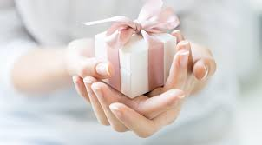
Activity 5
If you could give any gift in the world, what would you give and to whom.
Explain why you would choose that gift and why that that person deserves it.
ACTIVITY
0000005

Slide 8
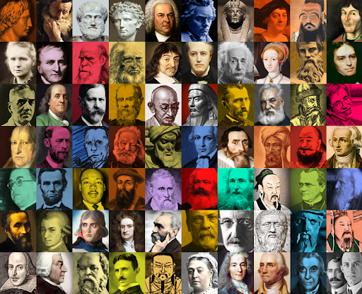
Activity 6
If you could spend the day with anyone throughout history who would it be and why? What would you like to do with that person?
ACTIVITY
0000006

